Slide 1


Let them use Cake
Chester Burbidge
CBurbidge
http://cburbidge.github.io/

Slide 2
Hands up.
Practice continuous integration
Use Teamcity/Appveyor/TFS to specify build logic

Slide 3
Whats the problem?
Lack of source control
Inabiliy to run locally
Long development feedback loop
Type of logic
Unclear dependencies
Vendor lock-in

Slide 4
Cake
Cake (C# Make) is a build automation system with a C# DSL to do things like compiling code, copy files/folders, running unit tests, compress files and build NuGet packages.

Slide 5
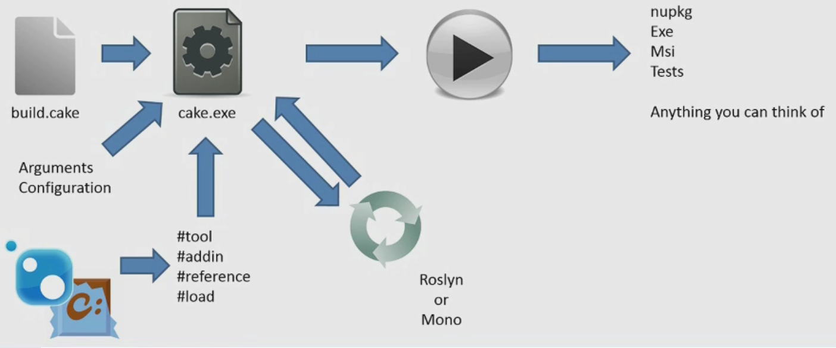
How does Cake work?

Slide 6
Cake – Important files
Build.ps1 – Bootstrapping script.
Installs Cake and required dependencies, invokes cake executable.
Build.cake – Contains C# build logic

Slide 7
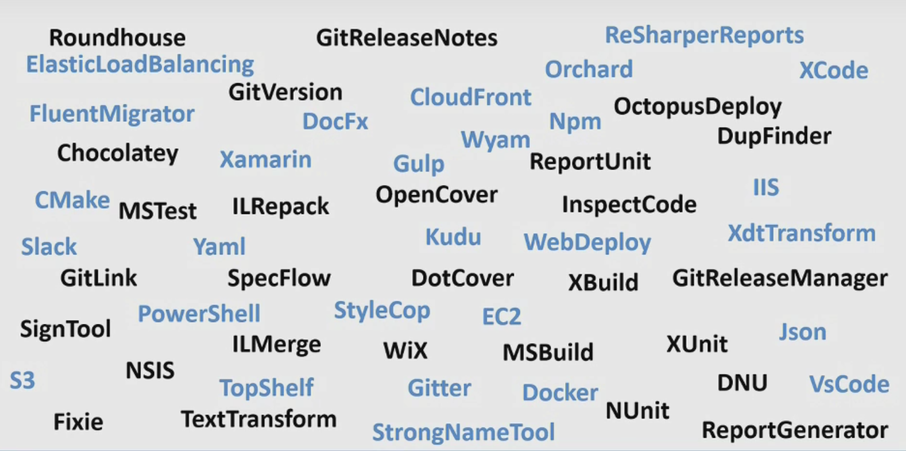

Slide 8
Cake - demo

